Slide 1
WHAT DO FORMS DO?
Provide user-friendly way to enter, edit, and delete data:
  Navigation buttons.
  Search & filter options.
  Combo boxes, list boxes and other powerful controls.
Display calculated information, looked up information, graphics, and more.
Can see either one record at a time or multiple records at a time.
Can see parent and child data on same form by using sub-forms.

Slide 2
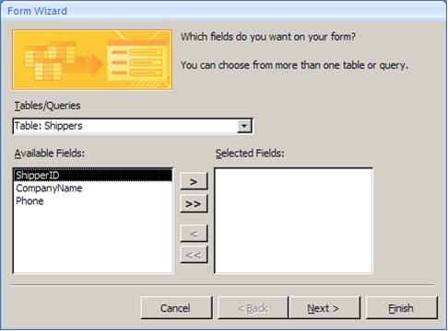
CREATING FORMS WITH THE ACCESS FORM WIZARD (STEP 1)
In the menu at the top of the window, click Create.
Click the dropdown beside the More Forms
icon in the toolbar. Then click Form Wizard.
Select the table or query upon which you want to base the form.
Move the fields you
want on the form to
the Selected Fields
list.

Slide 3
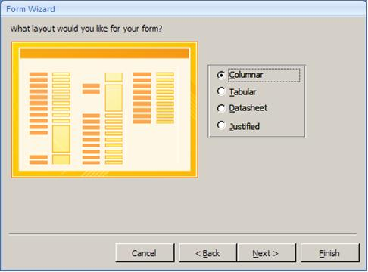
CREATING FORMS WITH THE ACCESS FORM WIZARD (STEP 2)
The Form Wizard then offers four kinds of layouts.
  Columnar
  Tabular
  Datasheet
  Justified

Slide 4
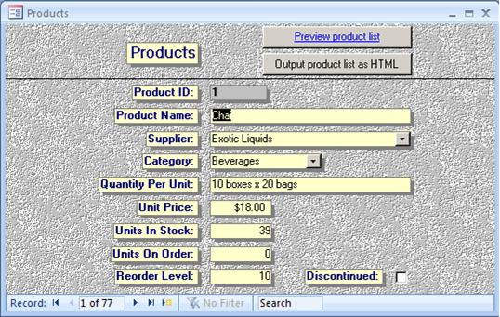
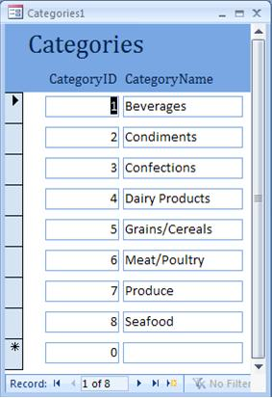
FORM LAYOUT CHOICES
Columnar Forms:
  Text boxes appear in a column down the screen but can be moved.
  Shows one record on the screen at a time.
  Used most often.
Tabular Form:
  Text boxes appear in a row across the screen.
  Shows multiple records on the screen at a time.
  Used for tables with few fields.

Slide 5
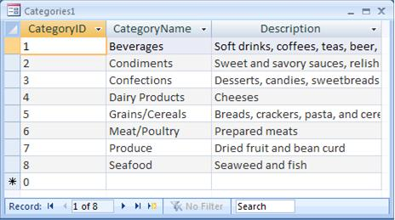
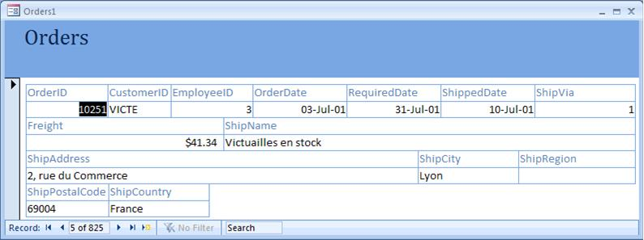
FORM LAYOUT CHOICES (CONT.)
Datasheet Form:
  Text boxes appear as in a table in rows and columns.
  Shows multiple records on the
  screen at a time.
Justified Form:
  Text boxes are spread across
  the screen with labels
  above the text boxes.
  Shows one
  record at a time.
  Used to duplicate
  the look of
  paper forms.

Slide 6
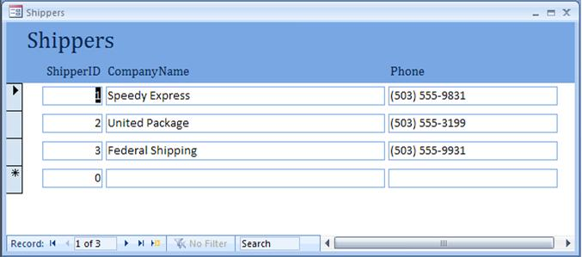
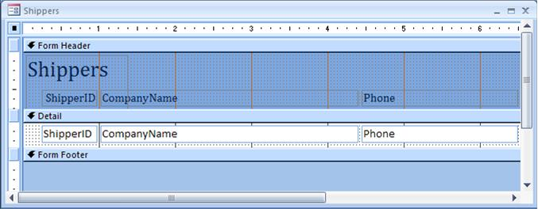
FORM VIEW & DESIGN VIEW
Form View is how users see the form and is used to enter data.
  Select with
Design View is used to modify the form’s structure.
  Select with

Slide 7
FORM VIEW & DESIGN VIEW (CONT.)
Note two objects on Design View are identified as ShipperID.
  One is a Label – unchanging text.
  One is a text box – Where data is displayed for each record.
Label
Text box

Slide 8

RESIZING FORM CONTROLS
Make sure there isn’t a control layout applied.
Click on any object on form.
  Little buttons on each corner
  and sides of the text boxes - used to resize it.
Horizontal Sizing:
  Position mouse over button at the left or right end of object. The mouse cursor should change to a two-headed arrow.
  Hold down left mouse button and drag to the left or right to make the text boxes horizontally smaller or larger.
Vertical Sizing:
  Position mouse over the button at top or bottom of object. The mouse cursor should change to a two-headed arrow.
  Hold down left mouse button and drag up or down to make the text boxes vertically smaller or larger.

Slide 9
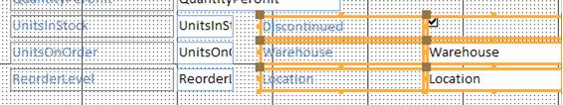
MOVING FORM CONTROLS
Select a control (or multiple controls):
  Click followed by Shift-click.
  Or drag marquee around multiple objects.
Position the mouse anywhere on a control other than on one of the sizing buttons:
  The mouse cursor should change to a four-headed arrow.
  Drag to move the control(s).

Slide 10

ALIGNING FORM CONTROLS
Select multiple objects:
  Click followed by Shift-click.
  Or drag marquee around multiple objects.
Click on Arrange in the menu at the top of the screen:
  Bottom.
  Top.
  Left.
  Right.
Access aligns objects, it always moves the selected objects to the rightmost, leftmost, topmost, or bottommost it can.

Slide 11
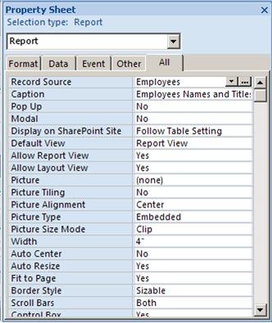

PROPERTY SHEET
Every object on a report (or form) has properties:
  Every label.
  Every text box.
  Every line.
  Every band.

Slide 12
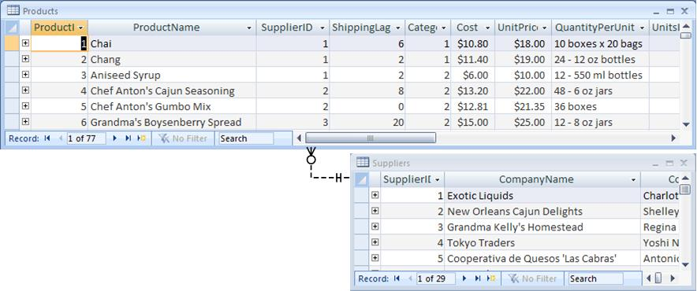
USING COMBO BOXES TO LOOKUP DATA
In Parent-Child relationship of Suppliers to Products, SupplierID is stored in Products table as foreign key.
Combo Boxes allow user to see text company name while still saving numeric SupplierID in field.
Note that this uses two tables:
  One you are entering data to.
  One for looking up values from.

Slide 13
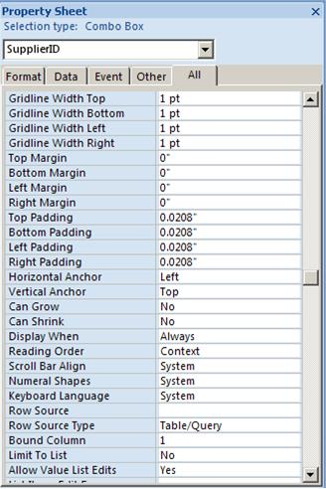
USING COMBO BOXES
TO LOOKUP DATA (CONT.)
Add combo box using toolbar
or right-click on text box and
change to Combo Box.
Set properties:
  Control Source is field in main table
  where data will be saved.
  Row Source Type set to Table/Query
  if pulling from another table.
  Row Source is SQL or the name of a
  saved query to drive the combo
  box list with data from lookup table.
  Column Count is number of columns in SQL.
  Bound Column is which column in SQL
  corresponds to Control Source field (PK).
  Column Widths is width of each column in
  Combo box (0;1").
  Width is width of combo box object
  (often sum of column widths plus .1").

Slide 14
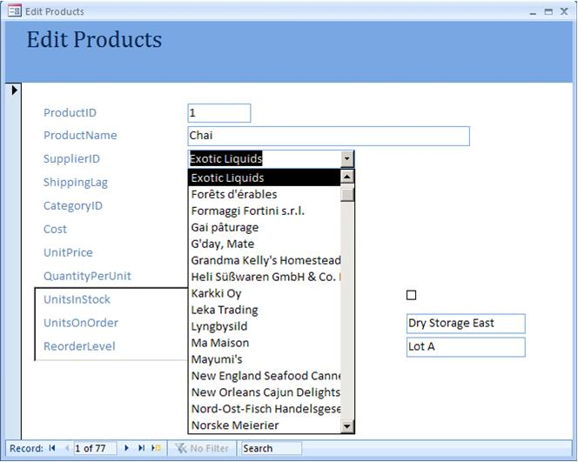
USING COMBO BOXES
TO LOOKUP DATA (CONT.)
Form edits records in Products table, including SupplierID field
Combo Box filled with info from Suppliers table (supplierid included but hidden)
Combo Box item automatically selected by matching Products.SupplierID with Suppliers.ProductsID

Slide 15
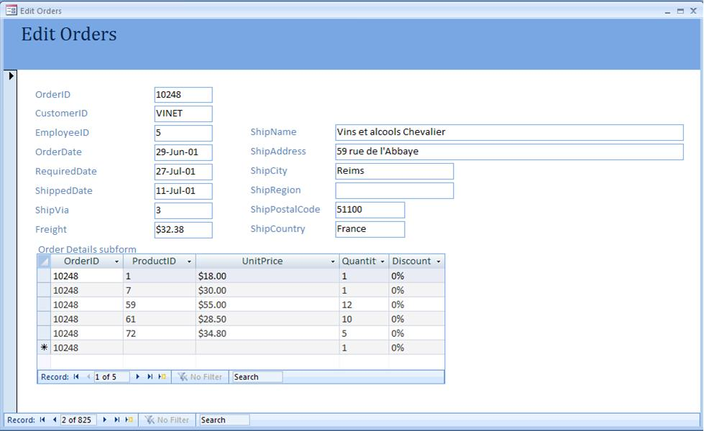
SUB-FORMS
Used with parent-child relationships.
Main form allows entry/edit of records for parent table.
Sub-form allows entry/edit of record
for child table.
Sub-form shows
only records
related to
currently viewed
parent record.
Main form with records of Orders table
Sub-form with related records in Order Details table

Slide 16
HOW TO CREATE SUB-FORMS
First create main form and space on it for sub-form.
Make sure the wizard is enabled on by making sure the Use Control Wizards icon in
the Design Toolbar is highlighted.
Click the Subform/Subreport tool in the toobar. Then click on your form where you want the sub-form to go. The wizard will start.

Slide 17
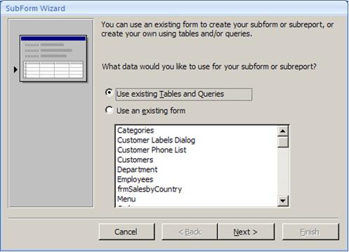
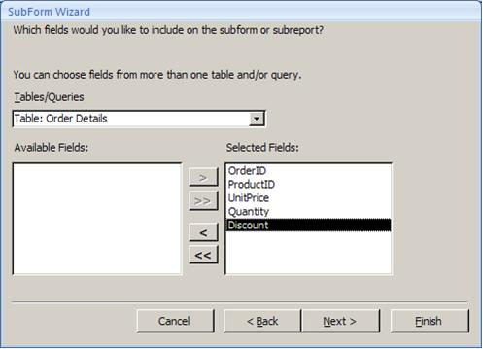
HOW TO CREATE SUB-FORMS (CONT.)
You can either use an existing form use a table or query and have the wizard create a new form.
If you select Use existing Tables and Queries, you will then be asked to select the table or query and the fields from it you want on the sub-form.
  Always select the foreign key field that links to the parent table.

Slide 18
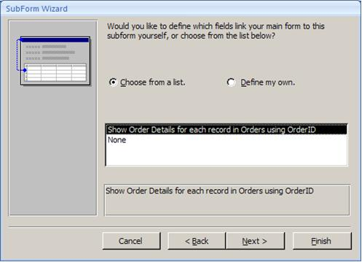
HOW TO CREATE SUB-FORMS (CONT.)
Select the fields used to link the form and sub-form together (PK-FK).
The wizard almost always selects the correct fields.
If not, select Define My Own.

Slide 19
REFINING THE SUB-FORM
Viewing the main form in form view, size the sub-form columns and hide the foreign key column.
  Close and save the form to save your changes.
In the Design view of the main form, size the sub-form object.
In the Design View of the sub-form, set the Navigation Buttons property to No.

Slide 20

CALCULATED TEXT BOXES ON FORMS
Click on the text box tool in the
controls section of the toolbar.
Click on the form where you want to create the text box.
Set the following Properties for the text box:
  Set the Name property to what makes sense.
  Set the Control Source to: = followed by a calculation using the names of other data form objects.
  Set the Format property to what is appropriate.
Set the Caption property of the related label.

Slide 21
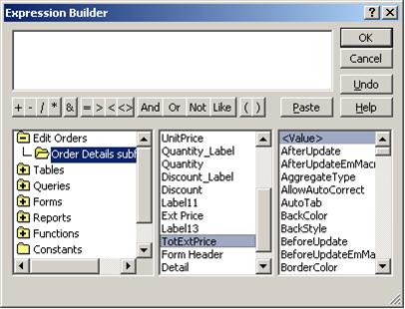
CALCULATING A TOTAL IN A SUB-FORM AND DISPLAYING IT ON A MAIN FORM
In the sub-form add a text box in the form footer:
  Set the Control Source property to =Sum(field) using the appropriate field or expression to sum up.
  Set the Name property to something that makes sense.
In main form add text box
where you want it to go:
  In the Control Source property,
  click the Build button to
  launch the expression builder.
  Browse to the name of the
  main form | the name of the
  sub-form object | the name of
  the text box on the sub-form.
  Click Paste to add it to the
  Expression Builder window
  Click OK.

Slide 22
FORM DESIGN GUIDELINES
Identify system inputs and review logical requirements.
Select appropriate GUI controls. See the table below that discusses the typical uses for the most common Microsoft Access controls.
Design, validate, and test inputs using layout tools and/or prototyping tools. Often Access is used as a prototyping tool for forms that will later be coded in another programming environment.
If necessary, design the source document. A source document is the paper form that is used to capture data for entry into the computer. Of course in many systems the data never goes to a paper form but gets directly entered to computer.

Slide 23
FORM DESIGN GUIDELINES (CONT.)
Control | Description & Appropriate Use | Notes
Text Box | A text box is a box in which a user can type any kind of text. Should be used when the data input values are unlimited. Examples: Address, Phone Number | The text box should be large enough for all characters of the data to be entered and viewed by the user. When the length is very long, a scrolling text box should be used. A text box should be accompanied by a descriptive, meaningful caption. In Access, captions are created with the Label tool. Avoid using abbreviations for captions. The first character of the caption's text should be capitalized, and the caption should end with a colon. The caption should be located to the left of the text box or left-aligned immediately above it.

Slide 24

FORM DESIGN GUIDELINES (CONT.)
Control | Description & Appropriate Use | Notes
List box | A list box requires that the user select one choice from a list of possible choices. Several, if not all, choices are displayed at once. If not all can be displayed, the user can scroll to the rest. Generally should be used when the data input values are: Limited More than can be shown with radio buttons Not so many that the list is unwieldy to scroll through | A list box should be accompanied by a descriptive, meaningful caption. In Access, captions are created with the Label tool. Avoid using abbreviations for captions. The first character of the caption's text should be capitalized, and the caption should end with a colon. The width of the list box should be large enough for the entire option to be seen. The list box should be tall enough to display three to seven choices. The order of options should conform to the preferences of the user.

Slide 25

FORM DESIGN GUIDELINES (CONT.)
Control | Description & Appropriate Use | Notes
Combo Box | A combo box includes the capabilities of a text box and a list box. Like a list box, it has a set of possible choices, which are viewed as a drop-down list. The user can select any of those options or type another value. In Access, the ability to type a value not in the list can be turned on or off with the "Limit to List" property. The equivalent "Select control" in web programming always limits choices to the list. A combo box is appropriate where screen space is too limited for a list box or radio buttons. | A list box should be accompanied by a descriptive, meaningful caption. In Access, captions are created with the Label tool. Avoid using abbreviations for captions. The first character of the caption's text should be capitalized, and the caption should end with a colon. The width of the list box should be large enough for the entire option to be seen. The order of options should conform to the preferences of the user.

Slide 26

FORM DESIGN GUIDELINES (CONT.)
Control | Description & Appropriate Use | Notes
Radio button | A radio button is a small circle and an associated description. Radio buttons allow the user to click to select only one of a group of options. Radio buttons are appropriate when the user needs to select one of a small number of predefined set of options. | Every radio button should be accompanied by a descriptive, meaningful caption. Radio buttons should present the alternatives vertically aligned and left-justified. If necessary, the choices can be presented horizontally aligned provided that adequate spacing is allowed to distinguish which description goes with which radio button. The group of mutually-exclusive choices should be grouped and set off from other input controls. In Access this can be easily done using the Option Group tool and its wizard. The order of options should conform to the preferences of the user.

Slide 27
FORM DESIGN GUIDELINES (CONT.)
Control | Description & Appropriate Use | Notes
Check box | A check box is a small square and an associated description. Radio buttons allow the user to click to select one or more of a group of options. Check boxes are appropriate for selections that are either on/off or true/false. With a group of check boxes you can implement a "check all that apply" scenario. | Every check box should be accompanied by a descriptive, meaningful caption. Look for opportunities to group check boxes with a descriptive group heading. Generally a group of check box controls should be aligned vertically and left justified. The order of options should conform to the preferences of the user.

Slide 28
EXERCISE
Create a columnar form for the Products table.
Change the Product ID textbox to a combo box.
Add an SQL statement to the control source to populate the combo box with both the Product ID and the Product Name.
Set the column count and column width to hide the Product ID.
Delete the original Product Name label and text box.
Revise the form in accordance to the form design guidelines.

